Slide 1

Audio Sampler iOS Application
Senior Project
Hunter Walker - Fall 2020

Slide 2
Young At Heart, Inc.
Client
What is Young At Heart?
Why does a mobile application make sense for the business?
(Why did I perform this project in this context)
What is the application and what is a sample?

Slide 3

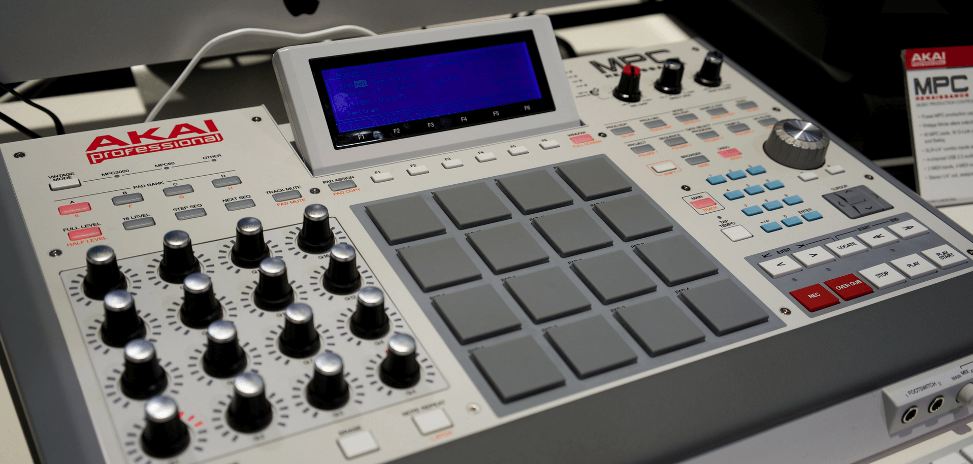
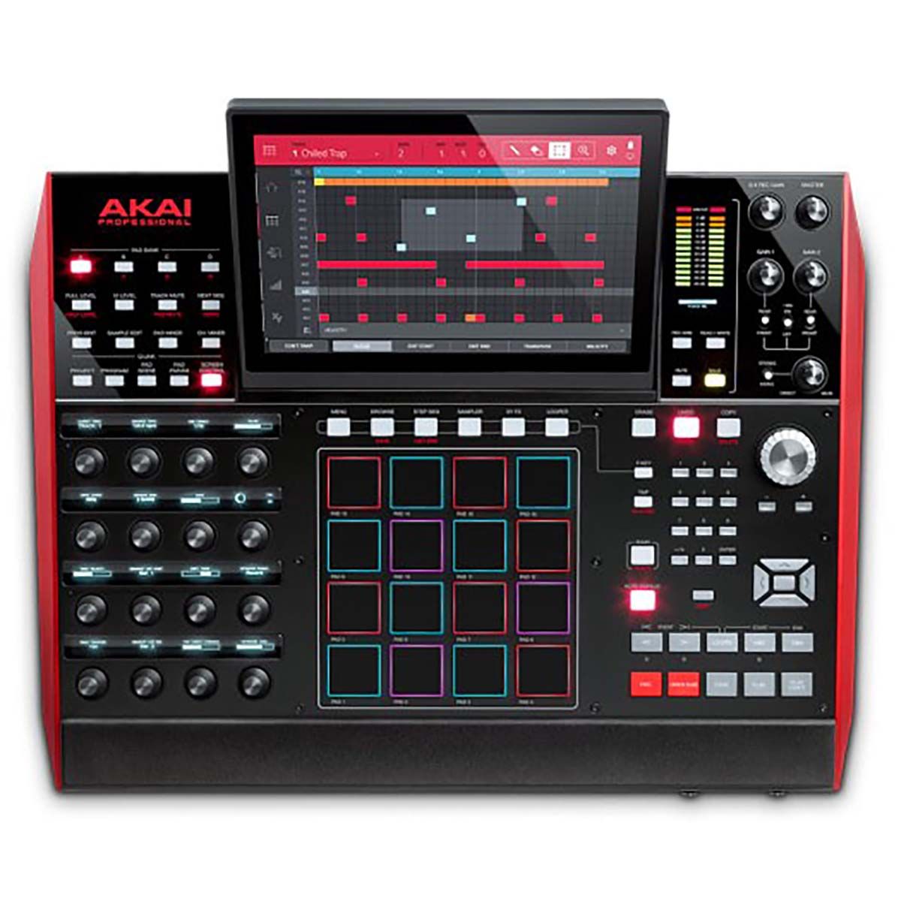
Akai MPC Sampler/Sequencer

Slide 4
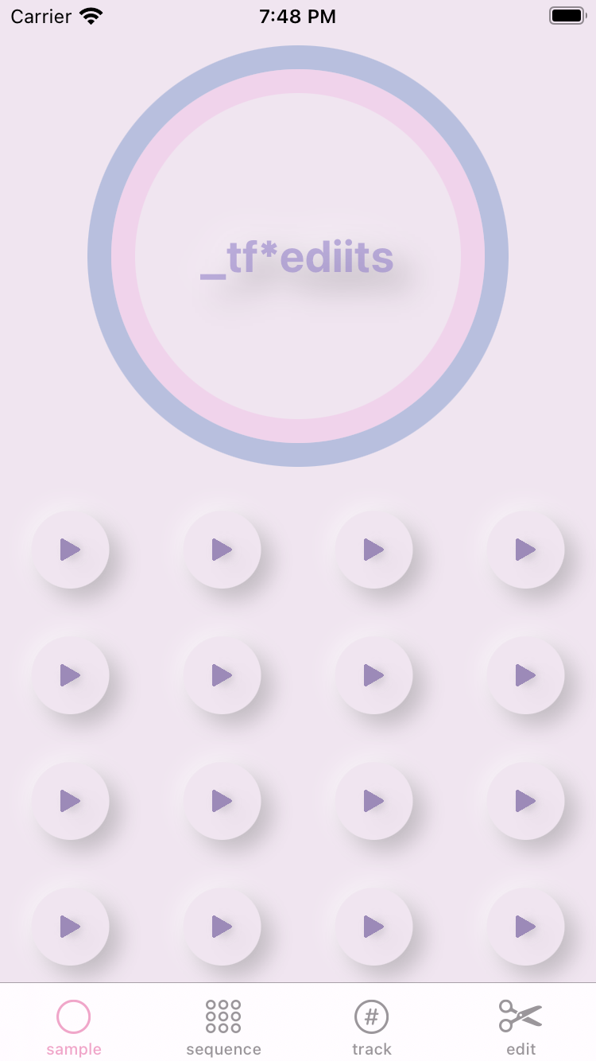
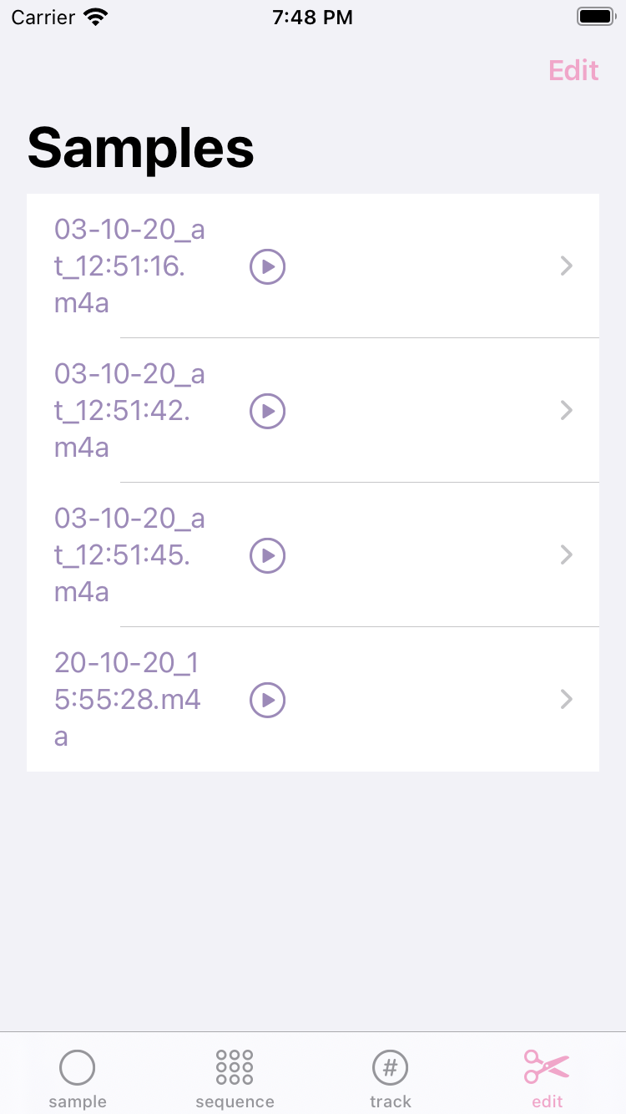
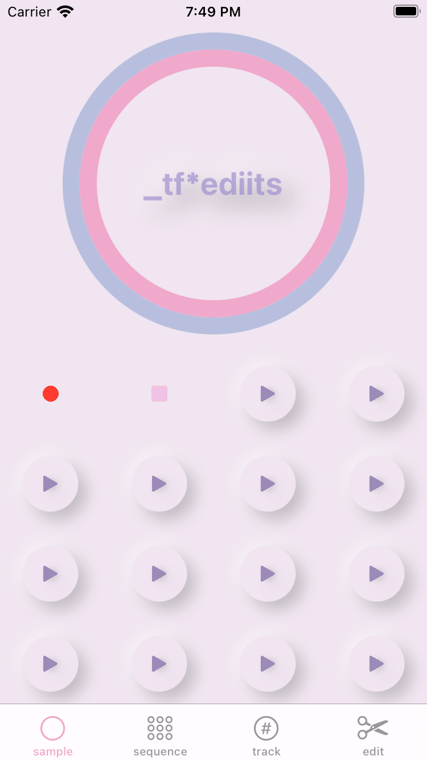
Objectives
Fully functional sampler fundamentals (recording, storing and playback)
Intuitive and visually appealing yet extremely simple UI
Usable within the context of writing or performing music

Slide 5
Background
The idea for the application has been around since around the same time that we started the business.
Future additions include the progress slider, sequence window, tracker window, fully realized editing window, physical unit, sample sharing, video inclusion and more.
Why Swift and SwiftUI?

Slide 6
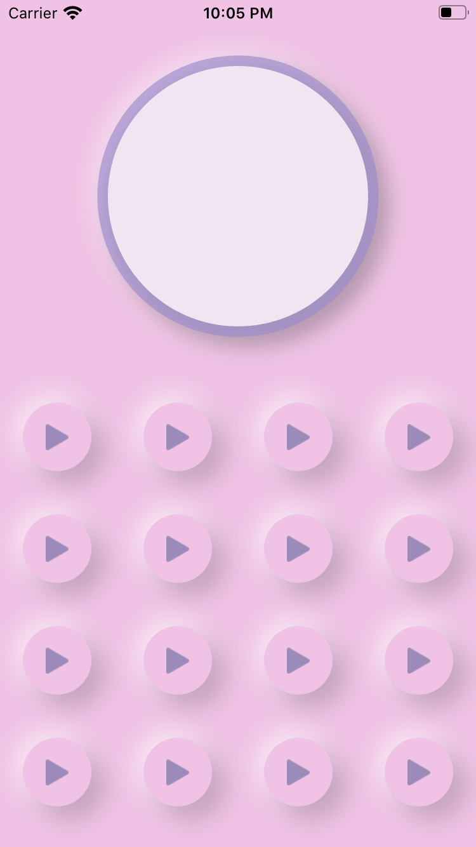
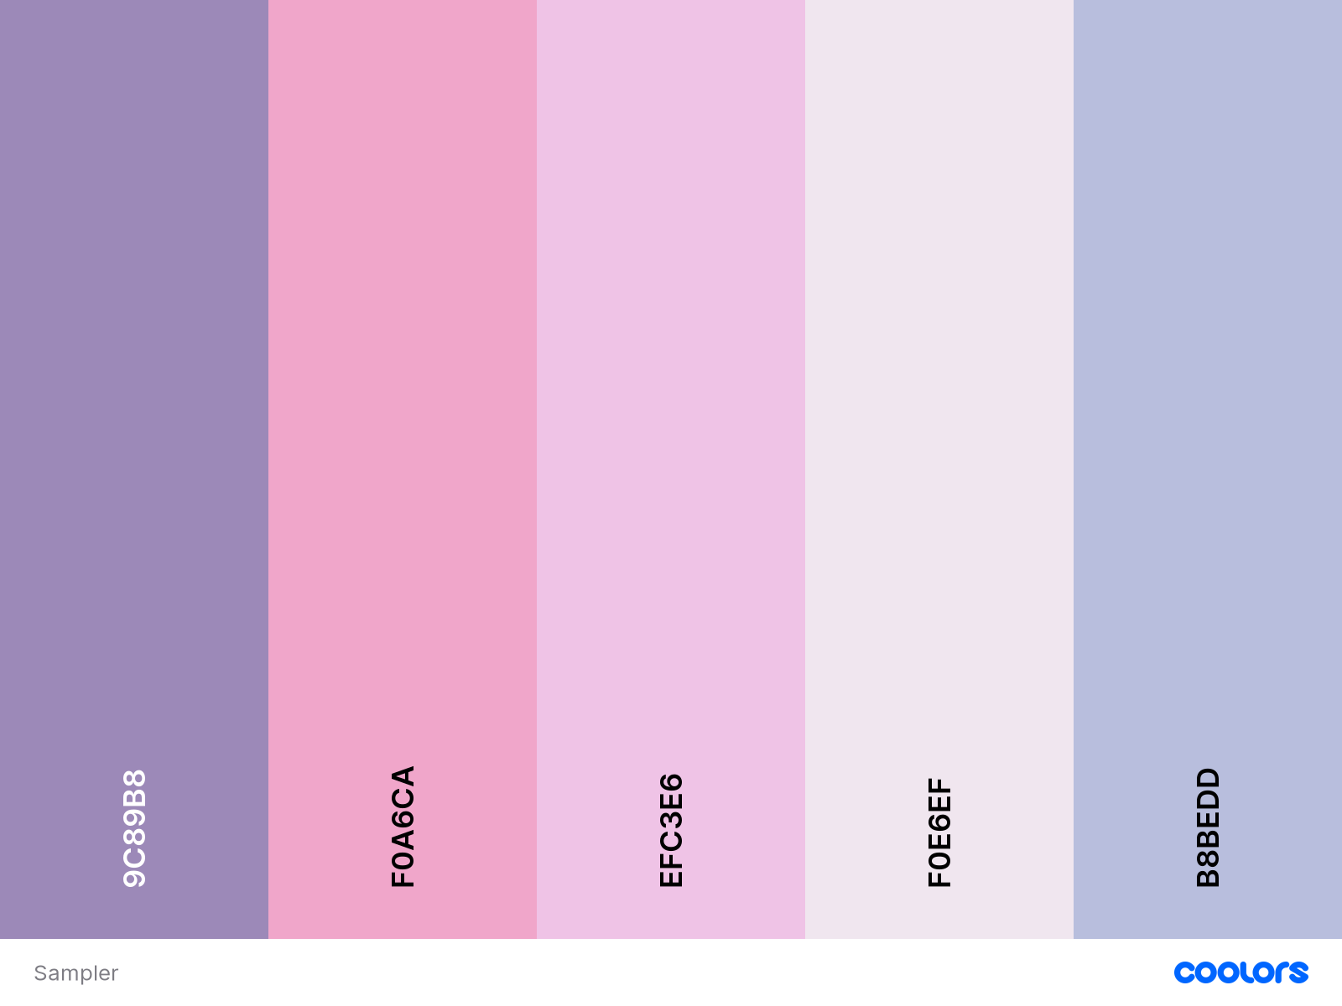
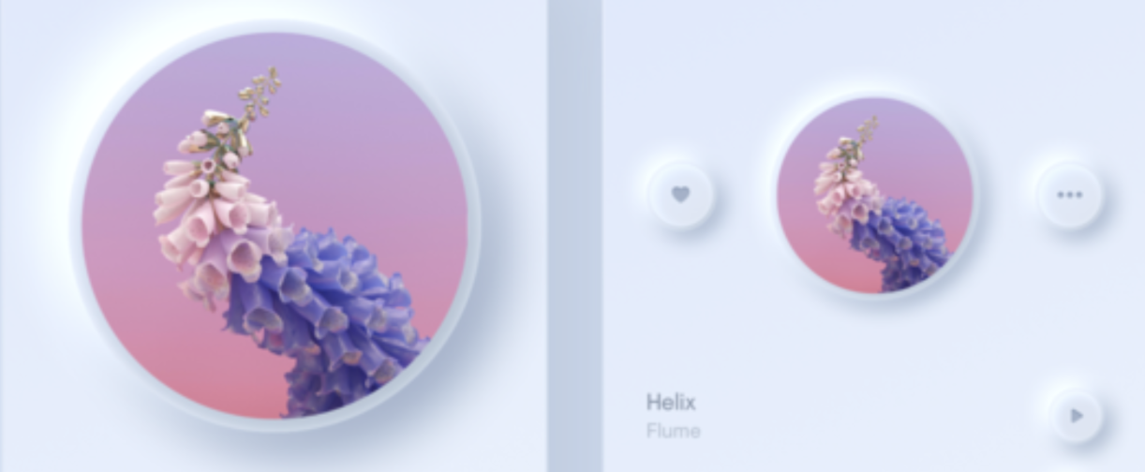

Slide 7
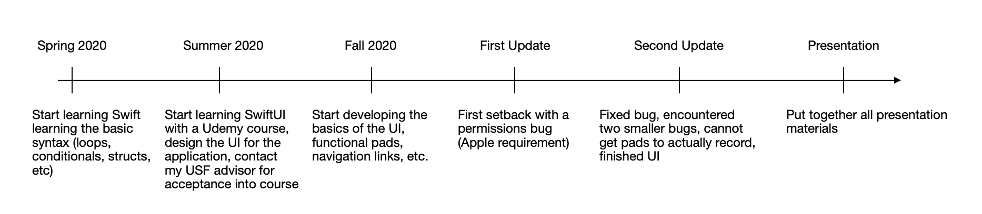
Project Timeline

Slide 8
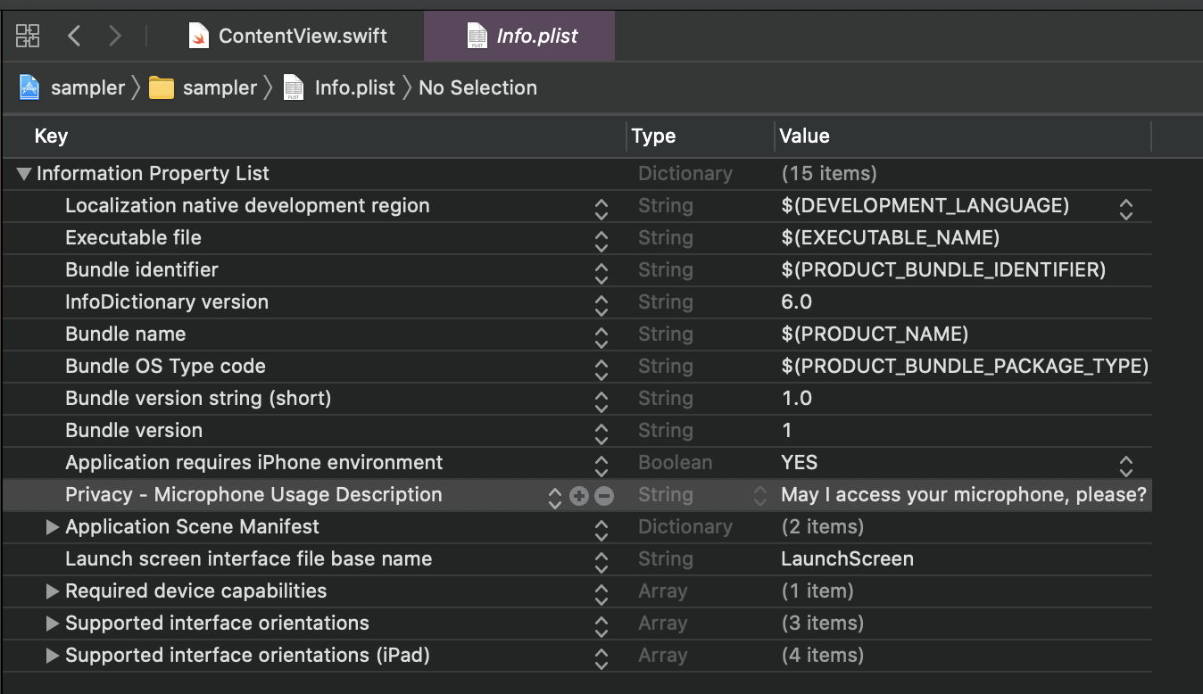
Timeline Setbacks
Permissions
Gestures vs buttons
Resetting the progress bar
Learning curve associated with the relatively new framework
Optimizing code that was far too complex

Slide 9
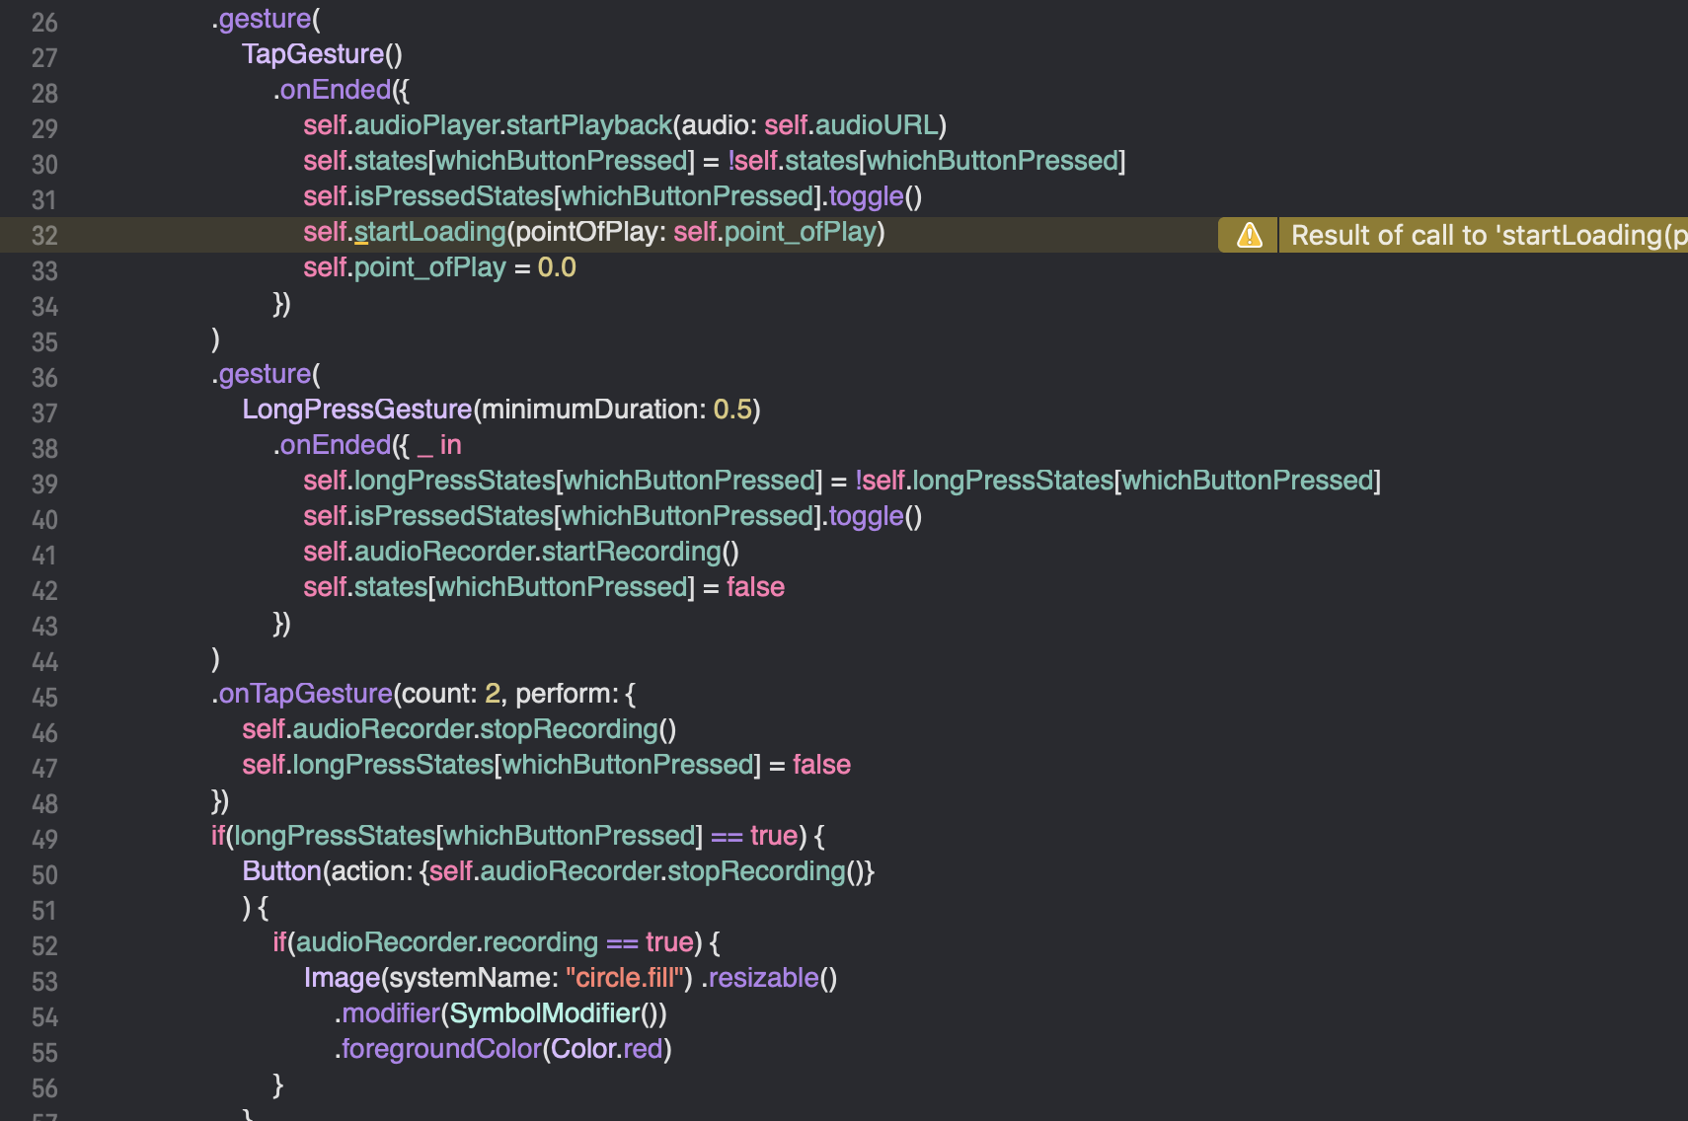

Slide 10
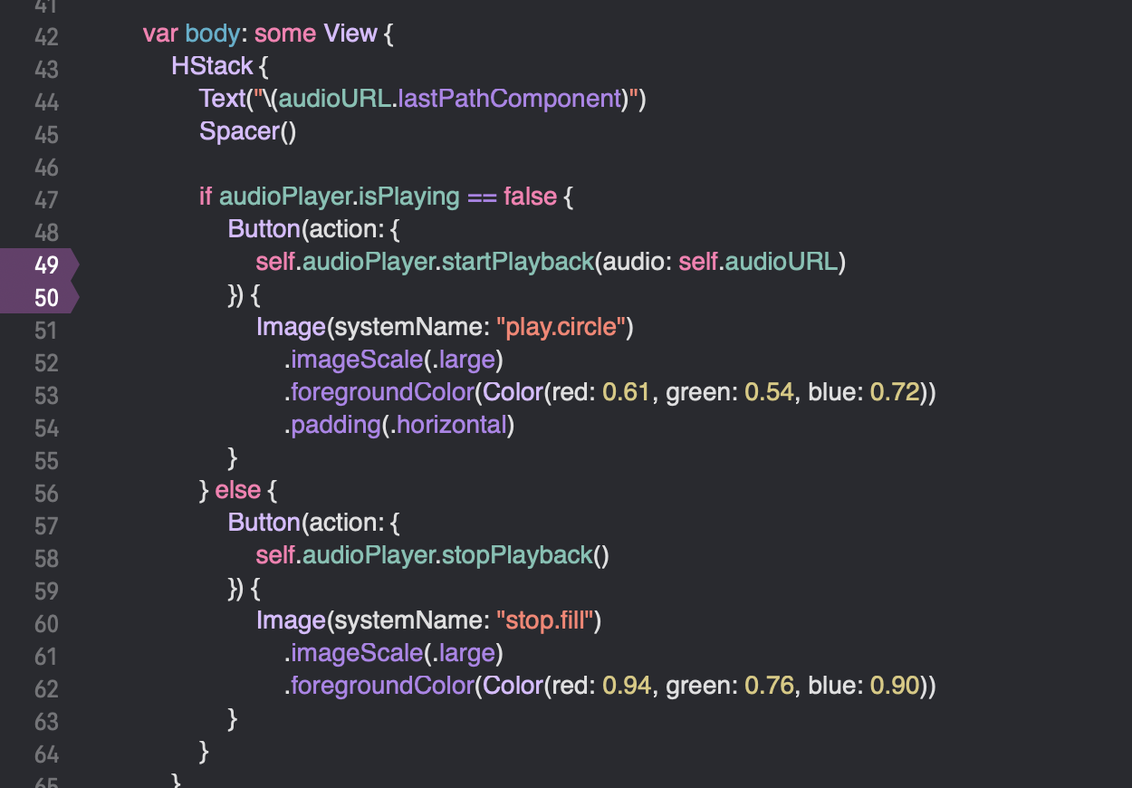

Slide 11
Requirements
Not many, my judgement was mostly trusted
Current conversations for where to go from here for our business including the future of the product
Some requests for future advanced features such as vintage emulations by decade

Slide 12
Quality Assurance
Regularly tested within Xcode iPhone simulator - Xcode provides build options for most Apple devices
Built on my own physical device regularly
There are still bugs within the application that I need to work out before I, or Apple, would consider it ready for the app store
Will continue to work on the application to work out these bugs and further the product

Slide 13
Implementation Thoughts
Performance
Capturing audio even outside of an artistic setting
Song writing on the go
All future additions, including sharing abilities
Eventual sale through the company

Slide 14
Conclusion
And Reflection

Slide 15
